Slide 1
AVL-Trees (Part 1)
COMP171

Slide 2
Data, a set of elements
Data structure, a structured set of elements, linear, tree, graph, …
Linear: a sequence of elements, array, linked lists
Tree: nested sets of elements, …
Binary tree
Binary search tree
Heap
…

Slide 3
Binary Search Tree
Review of ‘insertion’ and ‘deletion’ for BST
Sequentially insert 3, 2, 1, 4, 5, 6 to an BST Tree
If we continue to insert 7, 16, 15, 14, 13, 12, 11, 10, 8, 9

Slide 4
Balance Binary Search Tree
Worst case height of binary search tree: N-1
  Insertion, deletion can be O(N) in the worst case
We want a tree with small height
Height of a binary tree with N node is at least Θ(log N)
Goal: keep the height of a binary search tree O(log N)
Balanced binary search trees
  Examples: AVL tree, red-black tree

Slide 5
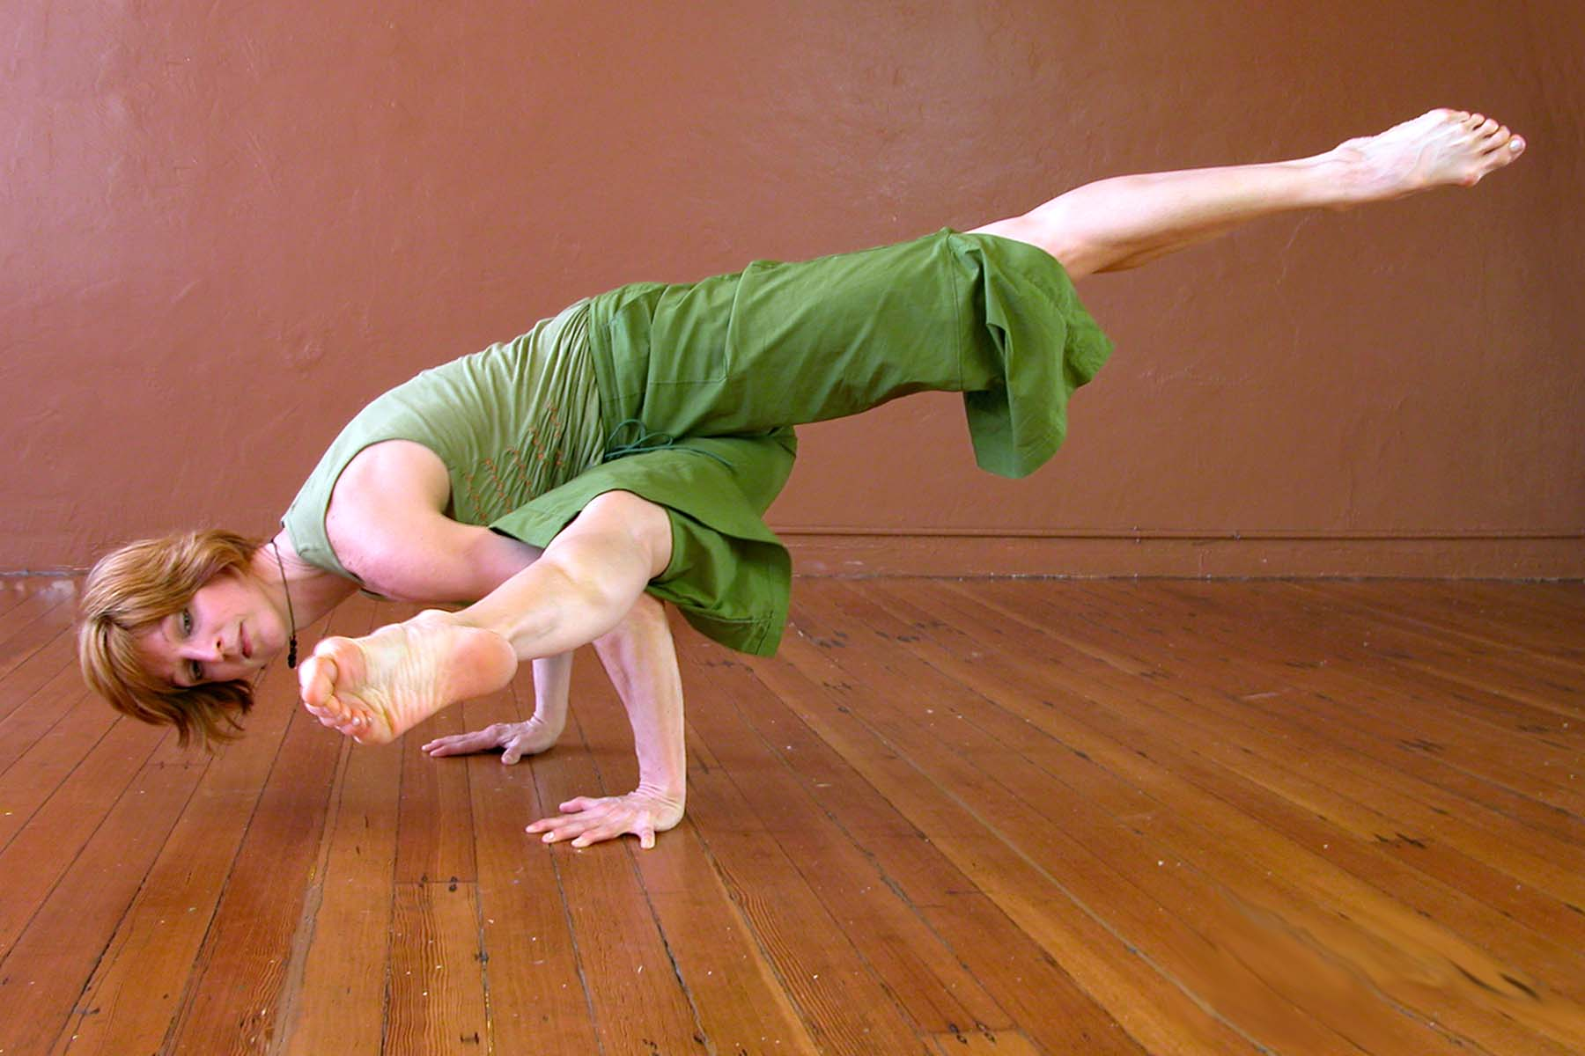
Balanced Tree?
Suggestion 1: the left and right subtrees of root have the same height
  Doesn’t force the tree to be shallow
Suggestion 2: every node must have left and right subtrees of the same height
  Only complete binary trees satisfy
  Too rigid to be useful
Our choice: for each node, the height of the left and right subtrees can differ at most 1

Slide 6
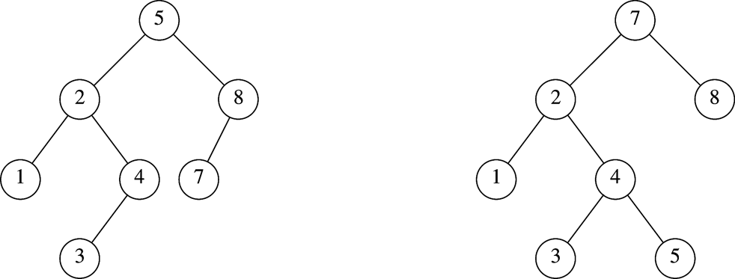
AVL Tree
An AVL (Adelson-Velskii and Landis 1962) tree is a binary search tree in which
  for every node in the tree, the height of the left and right subtrees differ by at most 1.
AVL tree
AVL property violated here

Slide 7
AVL Tree with
Minimum Number of Nodes
N₀ = 1
N₁ = 2
N₂ =4
N₃ = N₁+N₂+1=7

Slide 8
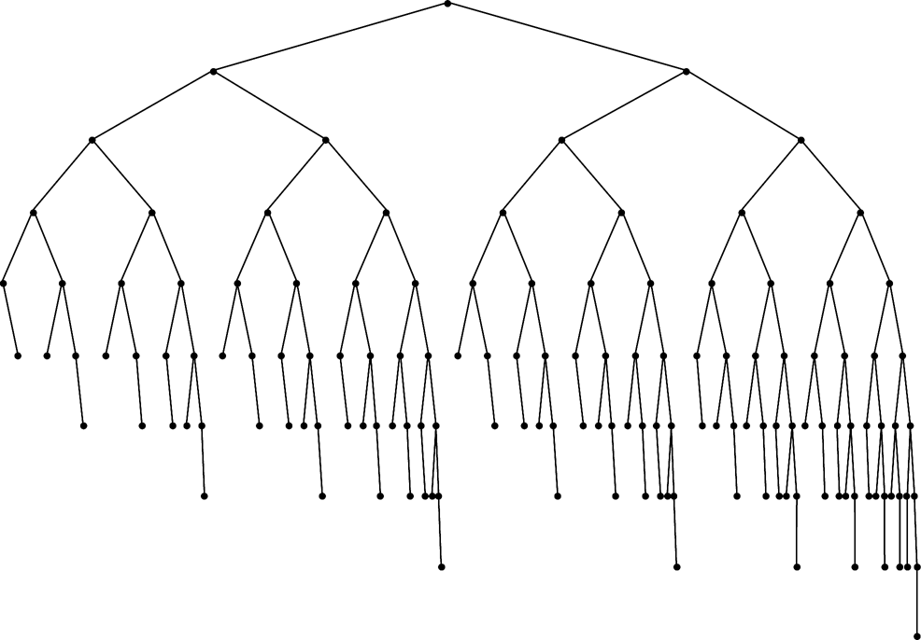
Smallest AVL tree
of height 7
Smallest AVL tree
of height 8
Smallest AVL tree of height 9

Slide 9
Height of AVL Tree
Denote N_{h} the minimum number of nodes in an AVL tree of height h
N₀=0, N₁ =2 (base)
N_{h}= N_{h-1} + N_{h-2} +1 (recursive relation)
N > N_{h}= N_{h-1} + N_{h-2} +1
>2 N_{h-2} >4 N_{h-4} >…>2^{i} N_{h-2i}
If h is even, let i=h/2–1. The equation becomes N>2^{h/2-1}N₂ ⇒ N>2^{h/2-1}x4 ⇒ h=O(logN)
If h is odd, let i=(h-1)/2. The equation becomes N>2^{(h-1)/2}N₁ ⇒ N>2^{(h-1)/2}x2 ⇒ h=O(logN)
Thus, many operations (i.e. searching) on an AVL tree will take O(log N) time

Slide 10
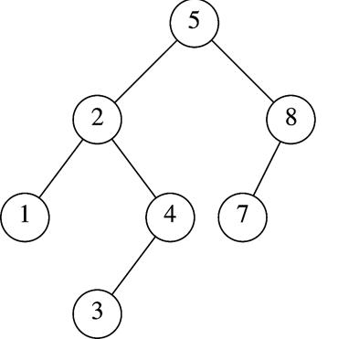
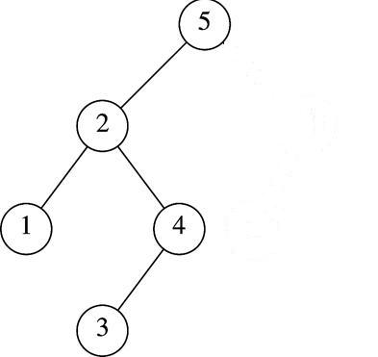
Insertion in AVL Tree
Basically follows insertion strategy of binary search tree
  But may cause violation of AVL tree property
Restore the destroyed balance condition if needed
7
6
8
6
Insert 6
Property violated
Original AVL tree
Restore AVL property

Slide 11
Some Observations
After an insertion, only nodes that are on the path from the insertion point to the root might have their balance altered
  Because only those nodes have their subtrees altered
Rebalance the tree at the deepest such node guarantees that the entire tree satisfies the AVL property
7
6
8
6
Node 5,8,7 might
have balance altered
Rebalance node 7
guarantees the whole tree be AVL

Slide 12

Different Cases for Rebalance
Denote the node that must be rebalanced α
  Case 1: an insertion into the left subtree of the left child of α
  Case 2: an insertion into the right subtree of the left child of α
  Case 3: an insertion into the left subtree of the right child of α
  Case 4: an insertion into the right subtree of the right child of α
Cases 1&4 are mirror image symmetries
with respect to α, as are cases 2&3

Slide 13
Rotations
Rebalance of AVL tree are done with simple modification to tree, known as rotation
Insertion occurs on the “outside” (i.e., left-left or right-right) is fixed by single rotation of the tree
Insertion occurs on the “inside” (i.e., left-right or right-left) is fixed by double rotation of the tree

Slide 14
Insertion Algorithm
First, insert the new key as a new leaf just as in ordinary binary search tree
Then trace the path from the new leaf towards the root. For each node x encountered, check if heights of left(x) and right(x) differ by at most 1
  If yes, proceed to parent(x)
  If not, restructure by doing either a single rotation or a double rotation
Note: once we perform a rotation at a node x, we won’t need to perform any rotation at any ancestor of x.

Slide 15
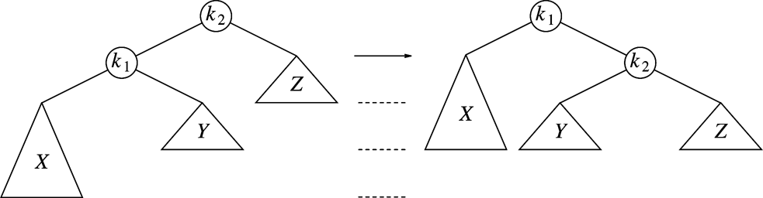
Single Rotation to Fix Case 1(left-left)
k2 violates
An insertion in subtree X,
AVL property violated at node k2
Solution: single rotation

Slide 16
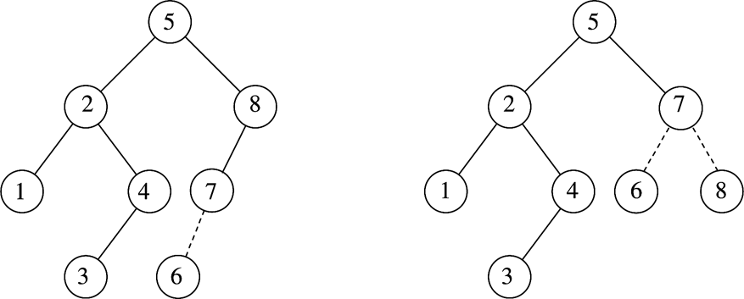
Single Rotation Case 1 Example
k2
k1
k1
X
k2
X

Slide 17
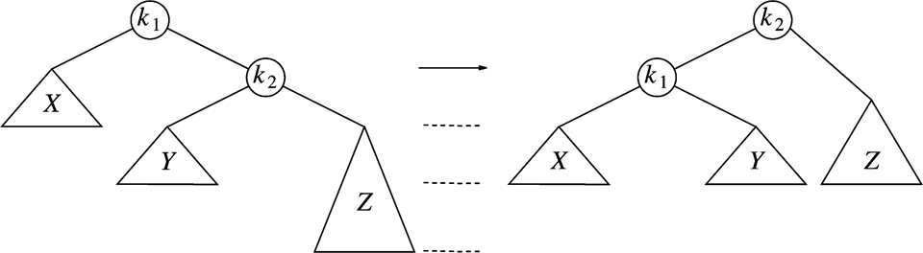
Single Rotation to Fix Case 4 (right-right)
k1 violates
An insertion in subtree Z
Case 4 is a symmetric case to case 1
Insertion takes O(Height of AVL Tree) time, Single rotation takes O(1) time

Slide 18
Single Rotation Example
Sequentially insert 3, 2, 1, 4, 5, 6 to an AVL Tree
3
3
2
2
2
2
2
1
3
1
3
1
3
Insert 3, 2
1
Single rotation
Insert 4
4
Insert 5,
violation at node 3
4
Insert 1
violation at node 3
2
2
5
4
1
4
1
4
2
5
3
5
3
5
1
3
6
Single rotation
Insert 6,
violation at node 2
6
Single rotation

Slide 19
If we continue to insert 7, 16, 15, 14, 13, 12, 11, 10, 8, 9
4
4
2
5
2
6
1
3
6
1
3
5
7
Insert 7,
violation at node 5
7
Single rotation
4
4
6
2
6
2
1
3
5
7
1
3
5
16
Single rotation
But….
Violation remains
15
Insert 16, fine
Insert 15
violation at node 7
16
15
7

Slide 20
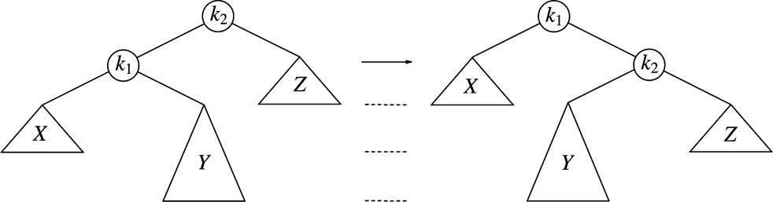
Single Rotation Fails to fix Case 2&3
Case 2: violation in k2 because of
insertion in subtree Y
Single rotation result
Single rotation fails to fix case 2&3
Take case 2 as an example (case 3 is a symmetry to it )
  The problem is subtree Y is too deep
  Single rotation doesn’t make it any less deep

Slide 21
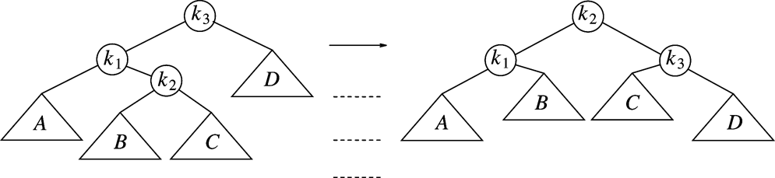
Double Rotation to Fix Case 2 (left-right)
Double rotation to fix case 2
Facts
  The new key is inserted in the subtree B or C
  The AVL-property is violated at k₃
  k₃-k₁-k₂ forms a zig-zag shape
Solution
  We cannot leave k₃ as the root
  The only alternative is to place k₂ as the new root

Slide 22
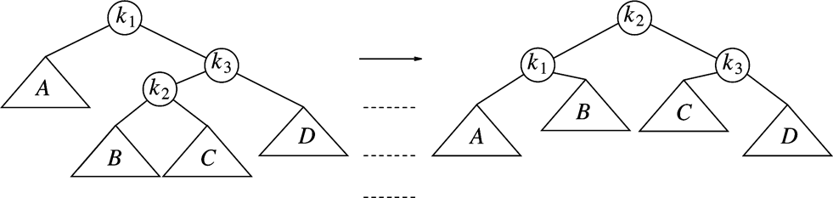
Double Rotation to fix Case 3(right-left)
Double rotation to fix case 3
Facts
  The new key is inserted in the subtree B or C
  The AVL-property is violated at k₁
  k₂-k₃-k₂ forms a zig-zag shape
Case 3 is a symmetric case to case 2

Slide 23
Restart our example
We’ve inserted 3, 2, 1, 4, 5, 6, 7, 16
We’ll insert 15, 14, 13, 12, 11, 10, 8, 9
4
4
2
6
2
6
1
3
5
7
k1
1
3
5
15
k2
Insert 16, fine
Insert 15
violation at node 7
16
k3
7
16
Double rotation
k1
k3
15
k2

Slide 24
4
4
2
6
k1
2
7
k2
A
1
3
5
15
k3
1
3
6
k1
15
k3
k2
7
16
D
5
14
16
Insert 14
14
C
Double rotation
4
k1
7
X
2
7
k2
4
15
1
3
6
15
2
6
14
16
Insert 13
5
14
16
1
3
5
13
Y
Z
Single rotation
13

Slide 25
7
7
4
15
4
15
2
6
14
16
2
6
13
16
1
3
5
13
1
3
5
12
14
Insert 12
12
Single rotation
7
7
4
13
4
15
2
6
12
15
2
6
13
16
1
3
5
11
14
16
1
3
5
12
14
Insert 11
Single rotation
11

Slide 26

7
7
4
13
4
13
2
6
12
15
2
6
11
15
1
3
5
11
14
16
1
3
5
10
12
14
16
Insert 10
10
Single rotation
7
7
4
13
4
13
2
6
11
15
2
6
11
15
1
3
5
8
12
14
16
1
3
5
10
12
14
16
9
10
8
Insert 8, fine
then insert 9
9
Single rotation

